Slide 1
Object-Based Databases
Notes:
1

Slide 2
Object-Based Databases
Complex Data Types and Object Orientation
Structured Data Types and Inheritance in SQL
Table Inheritance
Array and Multiset Types in SQL
Object Identity and Reference Types in SQL
Implementing O-R Features
Persistent Programming Languages
Comparison of Object-Oriented and Object-Relational Databases
Notes:
2

Slide 3
Object-Relational Data Models
Extend the relational data model by including object orientation and constructs to deal with added data types.
Allow attributes of tuples to have complex types, including non-atomic values such as nested relations.
Preserve relational foundations, in particular the declarative access to data, while extending modeling power.
Upward compatibility with existing relational languages.
Notes:
3

Slide 4
Complex Data Types
Motivation:
Permit non-atomic domains (atomic ≡ indivisible)
Example of non-atomic domain: set of integers,or set of tuples
Allows more intuitive modeling for applications with complex data
Intuitive definition:
allow relations whenever we allow atomic (scalar) values — relations within relations
Retains mathematical foundation of relational model
Violates first normal form.
Notes:
4

Slide 5
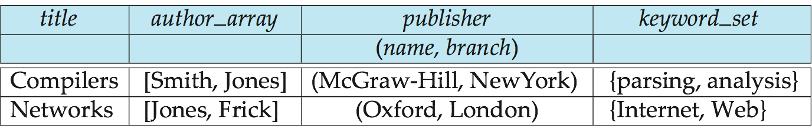
Example of a Nested Relation
Example: library information system
Each book has
title,
a list (array) of authors,
Publisher, with subfields name and branch, and
a set of keywords
Non-1NF relation books
Notes:
5

Slide 6
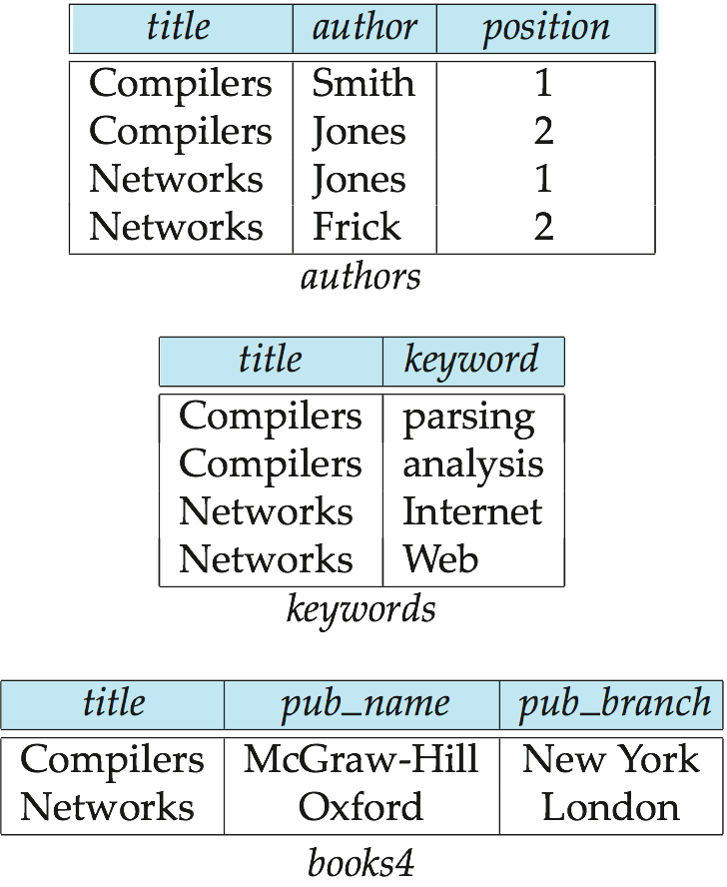
4NF Decomposition of Nested Relation
Suppose for simplicity that title uniquely identifies a book
In real world ISBN is a unique identifier
Decompose books into 4NF using the schemas:
(title, author, position )
(title, keyword )
(title, pub-name, pub-branch )
4NF design requires users to include joins in their queries.
Notes:
6

Slide 7
Complex Types and SQL
Extensions introduced in SQL:1999 to support complex types:
Collection and large object types
Nested relations are an example of collection types
Structured types
Nested record structures like composite attributes
Inheritance
Object orientation
Including object identifiers and references
Not fully implemented in any database system currently
But some features are present in each of the major commercial database systems
Read the manual of your database system to see what it supports
Notes:
7

Slide 8
Structured Types and Inheritance in SQL
Structured types (a.k.a. user-defined types) can be declared and used in SQL
create type Name as (firstname varchar(20), lastname varchar(20)) final
create type Address as (street varchar(20), city varchar(20), zipcode varchar(20))
not final
Note: final and not final indicate whether subtypes can be created
Structured types can be used to create tables with composite attributes
create table person (
name Name,
address Address,
dateOfBirth date)
Dot notation used to reference components: name.firstname
Notes:
8

Slide 9
Structured Types (cont.)
User-defined row types
create type PersonType as ( name Name, address Address, dateOfBirth date) not final
Can then create a table whose rows are a user-defined type create table customer of CustomerType
Alternative using unnamed row types.
create table person_r(
name row(firstname varchar(20),
lastname varchar(20)),
address row(street varchar(20),
city varchar(20),
zipcode varchar(20)),
dateOfBirth date)
Notes:
9

Slide 10
Methods
Can add a method declaration with a structured type.
method ageOnDate (onDate date)
returns interval year
Method body is given separately.
create instance method ageOnDate (onDate date)
returns interval year
for CustomerType
begin
return onDate - self.dateOfBirth;
end
We can now find the age of each customer:
select name.lastname, ageOnDate (current_date)
from customer
Notes:
10

Slide 11
Constructor Functions
Constructor functions are used to create values of structured types
E.g. create function Name(firstname varchar(20), lastname varchar(20)) returns Name begin set self.firstname = firstname; set self.lastname = lastname; end
To create a value of type Name, we use new Name(‘John’, ‘Smith’)
Normally used in insert statements insert into Person values (new Name(‘John’, ‘Smith), new Address(’20 Main St’, ‘New York’, ‘11001’), date ‘1960-8-22’);

Slide 12
Type Inheritance
Suppose that we have the following type definition for people:
create type Person (name varchar(20), address varchar(20))
Using inheritance to define the student and teacher types create type Student under Person (degree varchar(20), department varchar(20)) create type Teacher under Person (salary integer, department varchar(20))
Subtypes can redefine methods by using overriding method in place of method in the method declaration
Notes:
12

Slide 13
Multiple Type Inheritance
If our type system supports multiple inheritance, we can define a type for teaching assistant as follows: create type Teaching Assistant under Student, Teacher
To avoid a conflict between the two occurrences of department we can rename them
create type Teaching Assistant under Student with (department as student_dept ), Teacher with (department as teacher_dept )
Each value must have a most-specific type
Notes:
13

